Slide 1
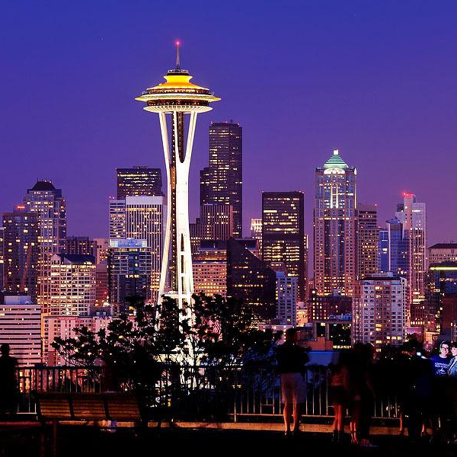
REGRESSION
CASE STUDY

Slide 2
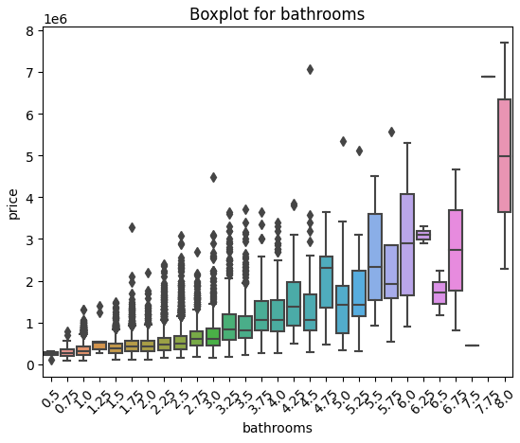
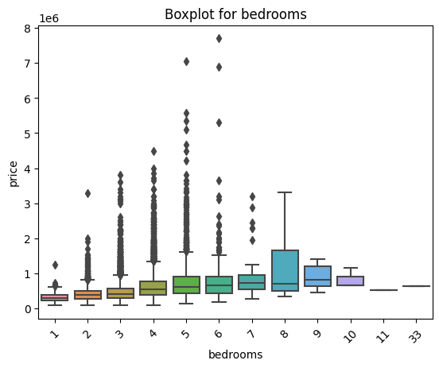
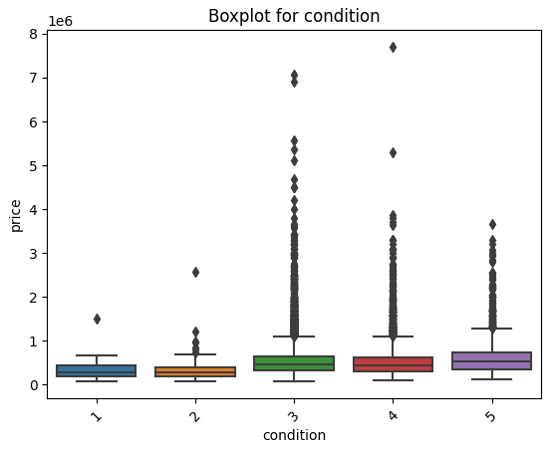
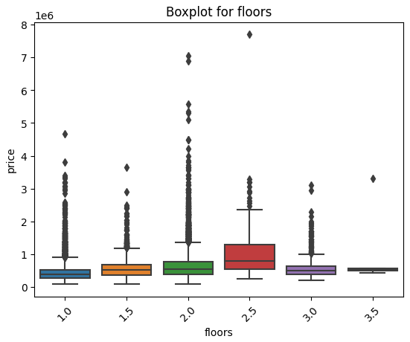
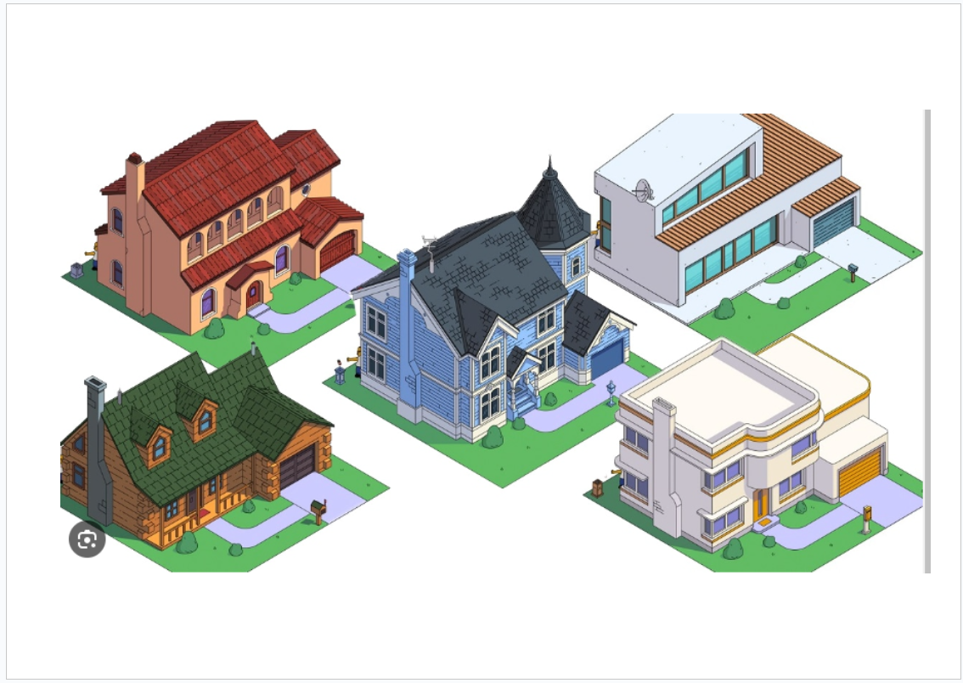
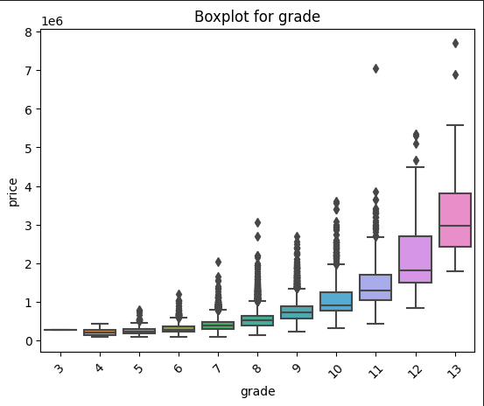
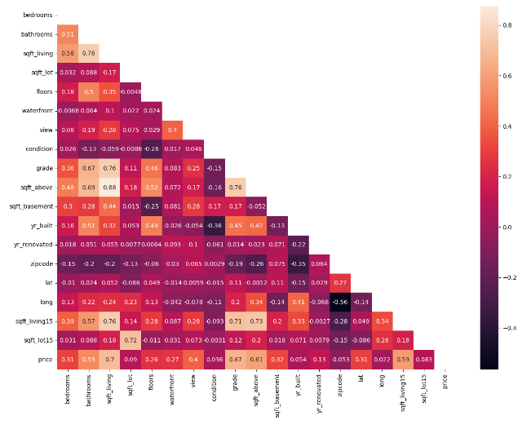
MARKET DATA ANALYSIS
Data Cleaning and Reevaluation (No Outliers)
Model Training & Evaluation (Original Data)
Feature Engineering and Selection
Data Visualization & Analysis
Data Transformation - Log Scaling
Model Training and Evaluation (Log-Transformed Data)
Data Exploring & preprocessing

Slide 3
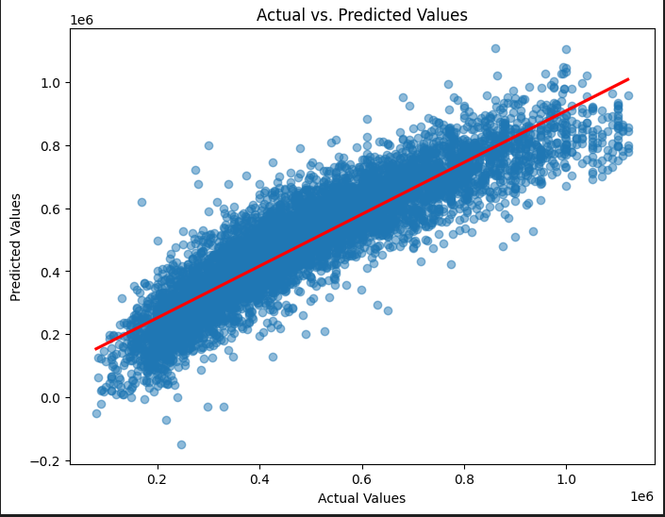

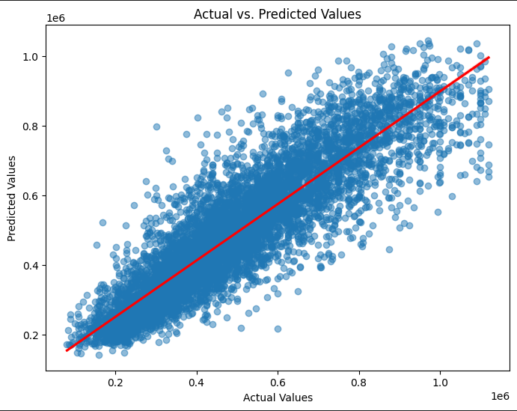

MODEL TRAINING COMPARISON
Model: KNeighborsRegressor R2_score: 0.81 RMSE: 91671.84 MAE: 64721.75 MAPE: 14.41 %
MODEL: LINEARREGRESSION R2_SCORE: 0.85 RMSE: 83001.44 MAE: 59168.01 MAPE: 13.12 %

Slide 4
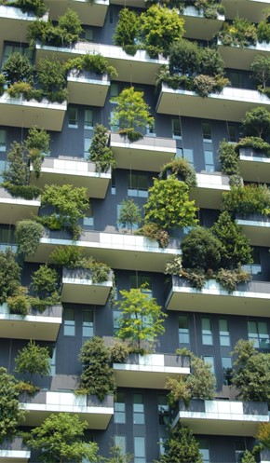
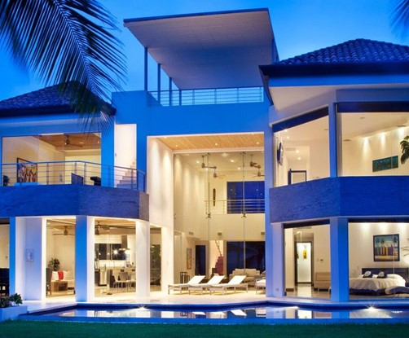
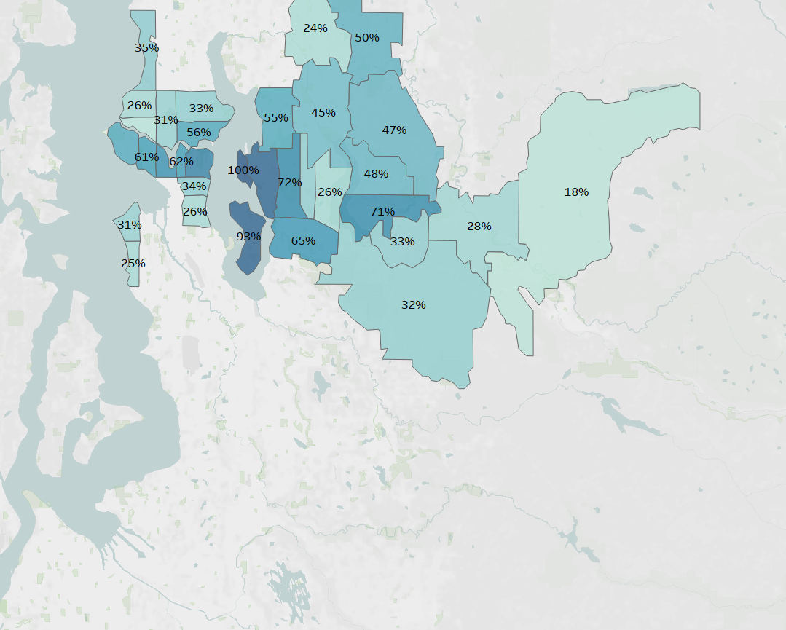
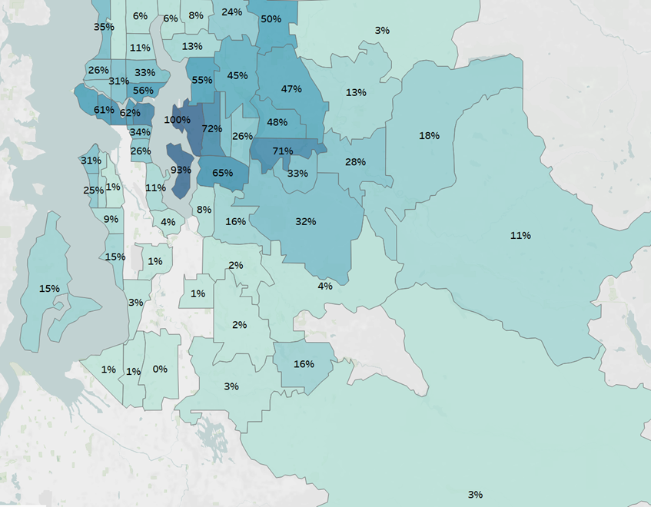
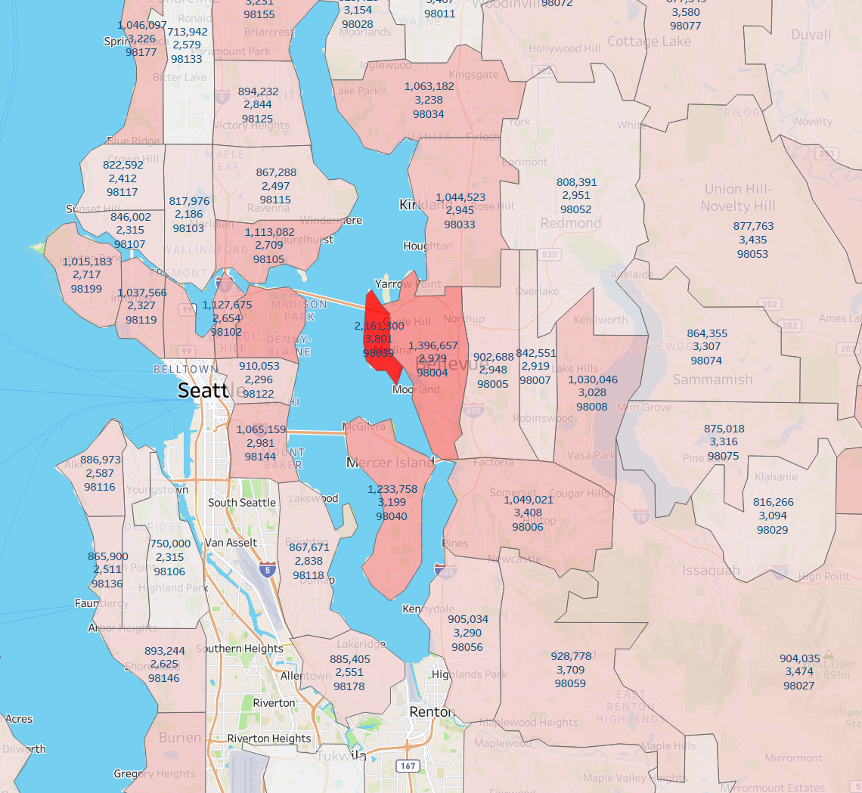
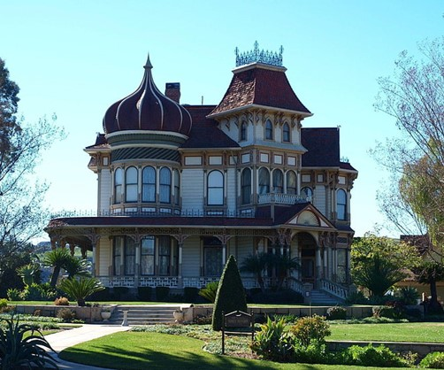
LOCATION AND PRICE
Above 650K
Ratio: 5322 / 21,597
Focus Area: Where more than 15% of house transaction price were above 650k
Transactions Period: 2 years.
Types
910,053 $
213m2
2,161,300 $
353m2
904,035 $
322m2
Notes:
Introduction: location really improved our machine learning model.
Target House Price: $650K. Some areas had only a tiny percentage of them. If we had limited resources, we can focus where over 15% of houses hit our target for the past 2 yrs.
House Types and Locations: We could see different house types w.r.t each areas. Heading to the east, we get bigger and affordable houses. But fancy places like Medina, the middle red area you only find luxurious houses.
Conclusion: To wrap it up, our prediction model did a great job, with just a 13% average error. Key factors were location, space, and house grade.
And lastly - we excluded outliers which is price above $1,130,000. so our prediction can be less accurate for those luxury houses.
Thank you for your attention. If you have any questions. Please ask us.
waterfront, 21434 / 163
also seen in grades past 11.

Slide 5
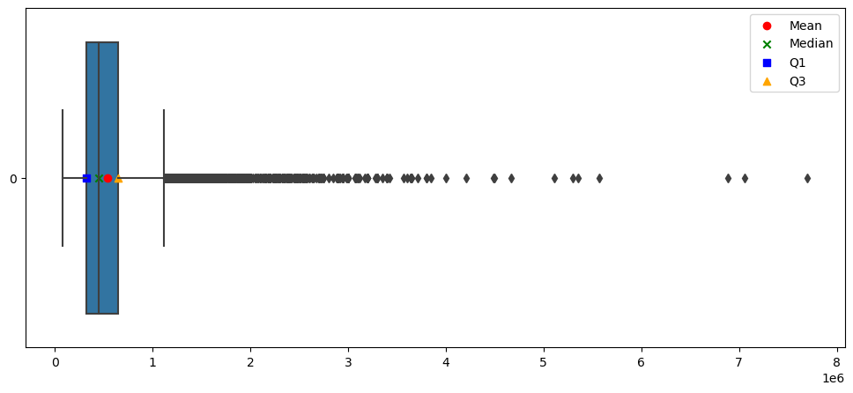

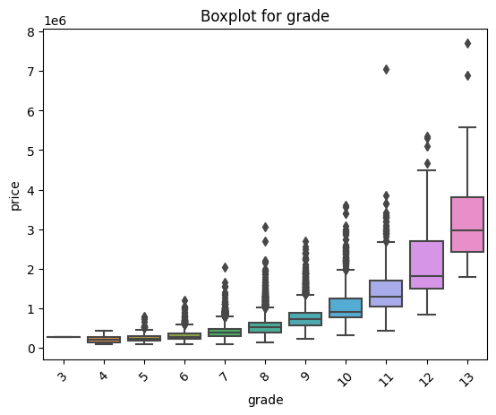
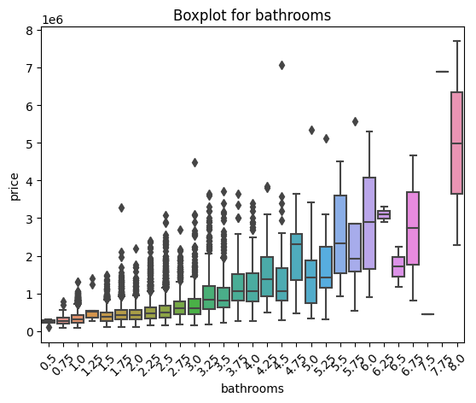
CONCLUSION
Our model achieved 85% R2, average error of $83k or a percentage error of 13%.
Most influencing features were it’s location, size, and the house grade from king county.
Our prediction can be less accurate for those luxury houses price above 1,130k.
Mean 540,297
Upper B 1,130,000
Max 7,700,000
Water front
King County grading system
Bathrooms
Notes:
Introduction: location really improved our machine learning model.
Target House Price: $650K. Some areas had only a tiny percentage of them. If we had limited resources, we can focus where over 15% of houses hit our target for the past 2 yrs.
House Types and Locations: We could see different house types w.r.t each areas. Heading to the east, we get bigger and affordable houses. But fancy places like Medina, the middle red area you only find luxurious houses.
Conclusion: To wrap it up, our prediction model did a great job, with just a 13% average error. Key factors were location, space, and house grade.
And lastly - we excluded outliers which is price above $1,130,000. so our prediction can be less accurate for those luxury houses.
Thank you for your attention. If you have any questions. Please ask us.

Slide 6

THANK YOU
Catarina Sardo Cillian Keating HeeMin Yang
FLORA@CONTOSO.COM
HTTP://WWW.CONTOSO.COM/

